Slide 1

Deca-Cube
Progress Update and Prototype

Slide 2
Table of contents
Game Overview
Progress Made
To-Do
Code Review
Prototype Demonstration
Conclusion

Slide 3

Game overview
Deca-Cube remains a top-down collect-a-thon game
Player must collect ten items then return to starting area to win the game
Colliding with any enemy will result in a life lost
Losing all lives causes the player to lose the game

Slide 4
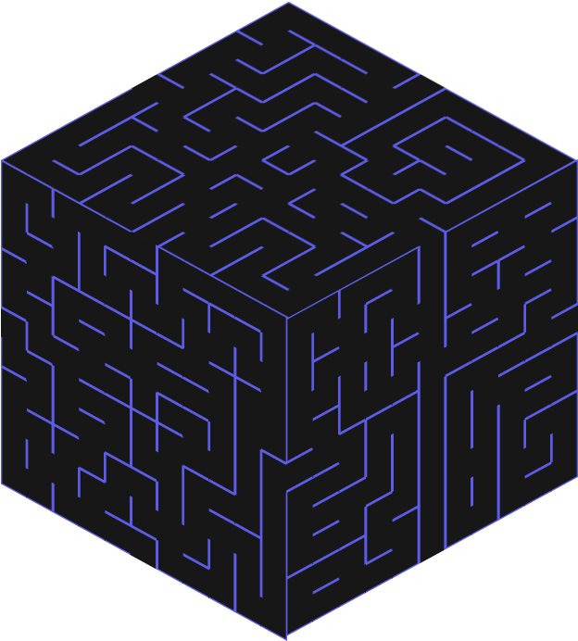
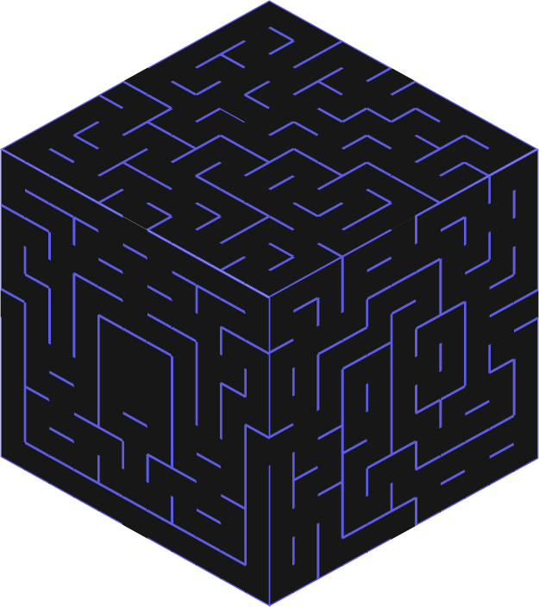
Progress made
All mazes put in game
All sprites created
All created sprites are stationary
Animations will come later on
Player’s movement system completed
Items implemented
Score tracked behind the scenes

Slide 5
To-do
Implement enemies and their behaviours
Add animations
Display score to player
Implement a life system and show game win and lose screen
Implement proper maze rotation

Slide 6









Enemies

Slide 7










Items

Slide 8
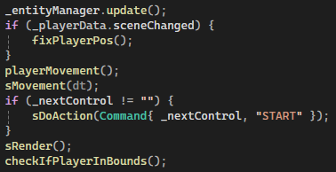
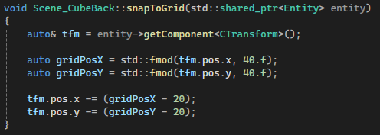

Code review

Slide 9
Demonstration

Slide 10

Thank you for listening

